Slide 1


Parents and Guardians:
Please ensure you have completed registration

Slide 2
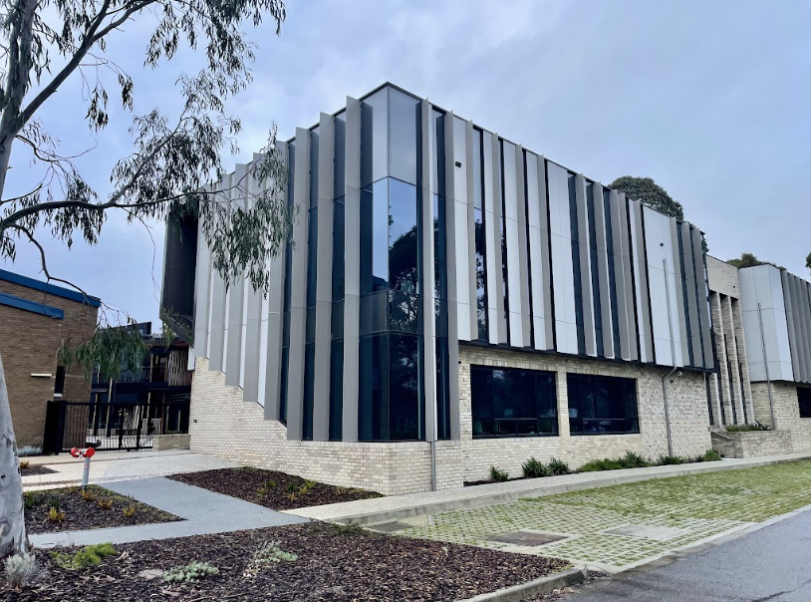

Year 11 (2027)
VCE & VCE VM
Course Selection Information Evening
Thursday, June 18
Notes:
Leave on this screen until 6.00pm

Slide 3
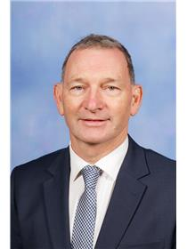
Welcome
Andrew Cooper
Deputy Principal (Learning)
Notes:
Good evening parents and guardians, staff and students.
I am Andrew Cooper, The Deputy Principal (Learning).
Welcome to the VCE and VCE Vocational Major Course Selection Evening.
.

Slide 4
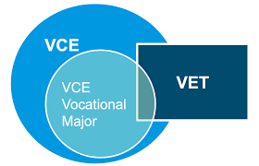
Notes:
Since 2023, The Victorian Government has incorporated the Victorian Certificate of Applied Learning (VCAL) into the VCE as a branch of the VCE Certificate, now known as the VCE Vocational Major.
The VCE VM has many of the characteristics of the former VCAL Program with potentially some added flexibility in subject choice and increased academic rigor particularly in Numeracy and Literacy.
Tonight, we will present an overview of both VCE Pathways; the traditional VCE Pathway and the new VCE Vocational Major Pathway.
Further, we will cover how a VET study can compliment both pathways.
And, we will outline the process for investigating and discussing these pathways as well as the process of choosing VCE subjects online from as early as tomorrow!

Slide 5

Acknowledgement of Country
Notes:
Before we do so, it is our pleasure to welcome _______________ and ______________ to do our Acknowledgment of Country and Prayer
“We would like to take this opportunity to respectfully acknowledge the traditional owners of this land on which our school is built. These people are called Wurundjeri.
We acknowledge the Elders, past and present, and ask the Creator God to challenge us to open our eyes to see the stories written, and to open our ears and hear the songs sung.
I would like to take this opportunity to respectfully acknowledge the traditional owners of this land on which our school is built. These people are called Wurundjeri.
We acknowledge the Elders, past and present, and ask the Creator God to challenge us to open our eyes to see the stories written, and to open our ears and hear the songs sung.”

Slide 6

Prayer
Lord, you call us by name and you call us to holiness, as you did St Joseph and St John Bosco.
We ask you to fill us with your spirit so that we, too, may reflect the life of your Son in our thoughts, attitude, words and actions.
Let us grow more aware of your presence in our lives and empower us to bring the good news of your love and salvation to all those you have entrusted to us, so that we may all become good Christians and honest citizens.
Amen.
Notes:
"Lord, you call us by name and you call us to holiness, as you did St Joseph and St John Bosco.
We ask you to fill us with your spirit so that we, too, may reflect the life of your Son in our thoughts, attitude, words and actions.
Let us grow more aware of your presence in our lives and empower us to bring the good news of your love and salvation to all those you have entrusted to us, so that we may all become good Christians and honest citizens.
Amen.”
Thankyou _______ and _____________
It is my pleasure now to introduce our Principal, Cathy Livingston

Slide 7
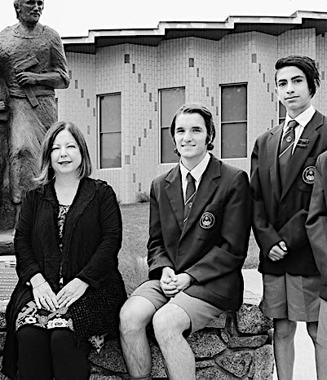
Principal’s Welcome
Cathy Livingston

Slide 8
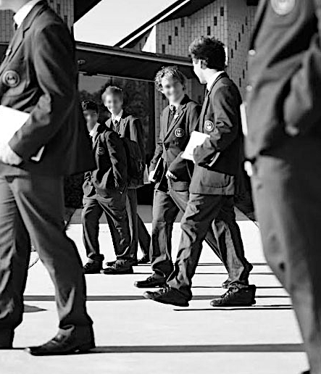
Year 11
2027
Notes:
Year 11 is a critical period of transition for our boys as they move into the VCE.
For some, their Pathways will lead them to Tertiary studies. For others, their pathway will be more immediately Vocational, leading these students towards Apprenticeships and/or TAFE or employment.

Slide 9



VCE
Year 11
2027
VCE Vocational Major (VCE VM)
Course Selection Process
Notes:
As mentioned previously, we will outline the details of both the VCE and VCE Vocational Major pathways tonight.

Slide 10

VCE
The Victorian Certificate
of Education
Notes:
Let's start with the VCE
What is it?

Slide 11



Senior secondary qualification
Administered by the VCAA (Victorian Curriculum Assessment Authority)
VCE
What is it?
Two-year certificate
Preparation for tertiary study
Notes:
The Victorian Certificate of Education (VCE) is a Senior Secondary Qualification. It is a two-year certificate, although it can be undertaken over more than two years without penalty.
It is administered by the Victorian Curriculum Assessment Authority, VCAA.
And as a consequence, school based decision making regarding minimum expectations for attendance and academic performance including examinations are overseen by this statutory authority of the Government of Victoria.
For students wishing to transition into University, successful completion of the VCE, with a suitable ATAR rank, above 50, and at least a study score for English above 25 are minimum requirements.

Slide 12



Each subject may be studied over four units, one per semester
VCE
How is it structured?
Year 11
Units 1 and 2
Year 12
Units 3 and 4
Maximum 23 units over
two years
Notes:
ACO
VCE studies are generally undertaken in Unit sequences.
Typically, students in Year 11 complete Unit 1 & 2 VCE studies including for example Unit 1 & 2 English sequence, Units 1 & 2 Biology sequence etc.
AtYear 12, typically students may continue this sequence into Unit 3 & 4 sequence, for example Unit 3 & 4 English, Unit 3 & 4 Biology
Over the course of their VCE, at St Josephs students will complete 23 Units of study. 16 is the minimum required for successful completion of the VCE or the VCE VM.

Slide 13




Every student completes an ENGLISH study in each of Year 11 and 12
In Year 11 students undertake an English and five other subjects
VCE
How is it structured?
In Year 12 students undertake an English and four other subjects
All students undertake Religious Education as part of their Year 11 and 12 studies
Notes:
Whilst most studies are optional, an English study is the exception.
Every student MUST complete an English study in Years 11 and in Year 12. In fact, students must receive a pass in a Year 12 English Unit 3 and 4 sequence to pass their VCE and, further, pass a minimum of three of the four English study units over the two years.
In addition to an English Block study, students select five other study sequences in Year 11. In Year 12, this is reduced to English plus four other study sequences.
Additionally, students also complete Religious Education as part of their Year 11 & 12 curriculum at St Joseph’s which does also contribute to the VCE Units of Study completed.
Whilst all students undertake an English study, there are some options as to which English study they can undertake (more about that later).
It is my pleasure to welcome our Head of English, Emily Watchman forward to outline these options in a little more detail.

Slide 14

Year 11 at
St Joseph’s
What about Year 11 English?
Emily Watchman
Head of English
Notes:
Thank you Andrew

Slide 15

English at Year 11
Year 11 at
St Joseph’s
Year 11 English
Choose at least one
Units 1 & 2 subject from the English block:
English
English Language

Slide 16
English at Year 11
Year 11 at
St Joseph’s
What about Year 11 English?
Literature
(must be undertaken with either English Language or English)
English as an Additional Language (EAL)
(conditions apply)

Slide 17
English
VCE
1. English option
Notes:
Mainstream option - study single analytical texts, analysing and presenting argument, comparative analysis
…

Slide 18


English Language
VCE
2. English Language option
A challenging English subject for students who love all aspects of language
By application
Notes:
English Language explores the construction of ideas conveyed through the communication of language.
Nature and functions of language, language acquisition, history and origin of English Language, varieties of English
No set novels/texts, does have textbook. Comprehensive new metalanguage list for students.

Slide 19

Literature
VCE
3. Literature
Undertaken in ADDITION to either English Language or English
Notes:
Literature explores language and the stylistic and aesthetic qualities of texts. Looks at how language, structure and stylistic choices are used in different literary forms and types of texts, interpretations of texts, relationship between texts/authors and context. Text heave subject - 4 complete texts as well as excepts from others. Range of texts from novels, poetry, short stories, scripts and a whole range of others

Slide 20

EAL
VCE
4. English as an Additional Language
(EAL) option
For students whose first Language is NOT English
Conditions apply
Notes:
Same SD as Mainstream English
For students, that English isn’t their first language
...
…will now outline details regarding VCE Mathematics options

Slide 21

Year 11 at
St Joseph’s
Year 11 Mathematics
Notes:
Thank you Emily,
In addition to an English studies: Mathematics, whilst not compulsory, is very much a preferred study by many tertiary institutions and is undertaken by the vast majority of VCE students in both Years 11 and 12.

Slide 22




Mathematics at Year 11
VCE
Choosing my Year 11 Course
What about Mathematics?
A mathematics pathway through VCE is highly recommended
Typically, students do at least one Unit 1 to 4 sequence
Some students do two Maths
Unit 1 to 4 sequence
Notes:
Students typically do at least one VCE Maths Study Sequence in Year 11 and 12. Some students choose to do two which is fine. If a students is doing Specialist Maths they in fact must also do maths Methods.

Slide 23

General Mathematics
VCE
1. General Mathematics
Articulates into Unit 3 & 4 General Mathematics
A Mathematics is favored for many University courses
Majority of Year 11 students complete General Mathematics
Notes:
The most common Maths undertaken in Year 11 and 12 is General Maths.
General Maths meets the requirements of successful completion of a Math Study for many tertiary studies.
It is considered the the more practical (daily life) of the three Maths but is in no way a simple Math, It focus’ on : Matrices, Financial Maths, Linear relations, Measurement and Trigonometry, Data analysis, and Networks

Slide 24



Mathematical Methods
VCE
2. Mathematical Methods
A challenging level of Mathematics
A prerequisite for some tertiary courses
Recommended: At least a ‘C+’ in Year 10 Mathematics (Methods)
Notes:
Maths Methods is a more challenging Maths involving abstract/logical/ deep thinking
It focus’ on: Linear relations (Algebra), Polynomials, Probability, Circular Functions, Calculus
Students sometimes make the error of thinking that struggling in Math Methods is akin to failing, its not. Struggling in Maths is a means to develop understanding.
Several Universities value this subject for the very fact it does identify those students capable of problem solving and abstract thinking, including Monash University for Comerce and Sciences courses.

Slide 25



Specialist Mathematics
VCE
3. Specialist Mathematics
A VERY challenging level of Mathematics
Must be taken in conjunction with Methods
For students consistently achieving a very high level in Year 10 Math Methods
Notes:
Specialist Mathematics can only be undertaken in combination with Math Methods.
Students with a strong aptitude for Maths should consider Specialist, particularly if they are considering Engineering or Actuary Pathways. Students should note that not doing Specialist or Methods doesn’t necessarily rule them out of pathways such as Engineering, but may limit their options regarding university and courses.

Slide 26

an English plus Five
Year 11 at
St Joseph’s
Choosing a Year 11 Course
What next?
Notes:
Choosing a Year 11 VCE course.
As mentioned, a study from the English block is required in Year 11.
In addition, students need to choose five other Unit 1 and 2 study sequences (or combination of Unit 1 and 2 and 3 and 4).

Slide 27


Accelerated Studies?
VCE
Continuing
Accelerated Studies?
Most accelerated studies commenced in Year 10 2026
Includes VCE (Unit 3 & 4) & some VET Studies
Limited opportunities for students to complete Unit 3 & 4 studies without completing
Units 1 & 2
Notes:
If your son has commenced an Accelerated Study and intends to continue it into Year 11 then this study would be their first subject sequence selection following their English study and compulsory RE option.
Whilst it is not generally advisable to do so, students can apply to pick up a Unit 3 & 4 study without doing Unit 1 & 2. This would be considered only in exceptional circumstances and only where the student has demonstrated a high level of aptitude for the chosen study area or related areas at Year 10. We have a form for that!

Slide 28


Accelerated Studies
VCE
Continuing
Accelerated Studies
Continued VET Acceleration:
Promotion subject to meeting competencies
Continued VCE Acceleration:
Students must achieve a ‘B+’ Overall Grade in Unit 1 & 2 to continue Acceleration into
Unit 3 & 4
Repeating (accelerated) subjects
or choosing other options available for students who do not meet promotion criteria
Notes:
Students who do wish to continue an Accelerated Study MUST achieve a B+ Overall Grade for this study in Unit 1 & 2 in 2026.
Some students have accelerated into VET studies.
Continuation in these subjects is also subject to first meeting this year's VET study competencies.
For students who do not achieve the B+ standard for an accelerated study this year or VET competencies, they have the option to repeat the study again in Year 11 in 2027 or choose an alternative Unit 1 and 2 sequence of studies moving forward.

Slide 29

Accelerated Studies
VCE
Continuing
Accelerated Studies
By online application form
Due:
9am, Friday July 24
Notes:
Students who are accelerating will need to complete an application for continuation of their accelerated subject in addition to listing the accelerated study on the online Subject application form.

Slide 30
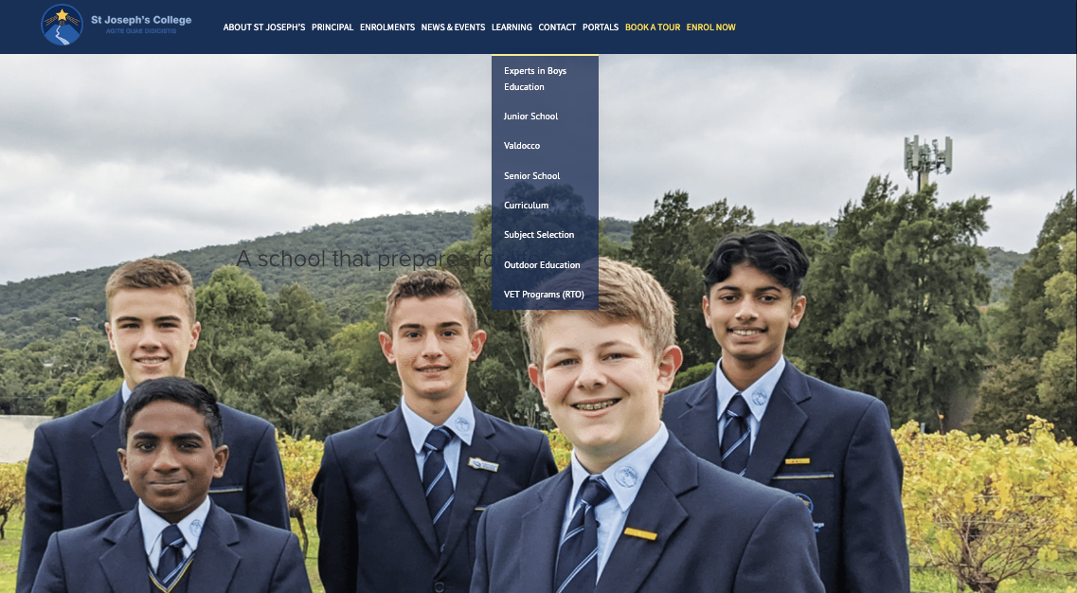
Notes:
All ‘forms’ will be available for completion online from the drop-down menu of the College website.

Slide 31
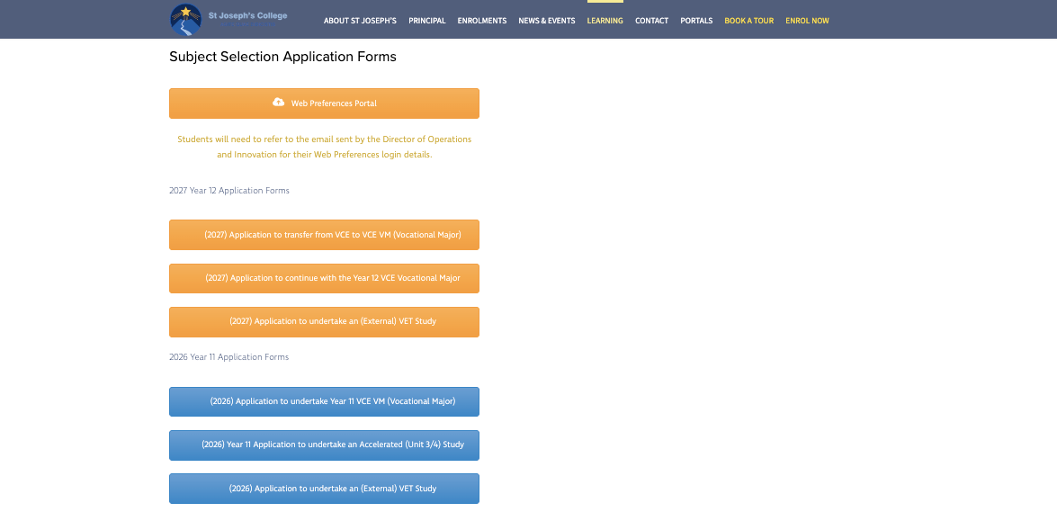
Notes:
More details to follow.

Slide 32



The key questions
VCE
What should I think about when choosing my VCE subjects?
Am I good at this subject?
Do I enjoy this subject?
Do I need this subject?
Notes:
In choosing the remainder of their Year 11 VCE Program, students should continue to consider these three important questions:
. What am I good at
. What do I like
. What do I need

Slide 33




VCE
What is available?
The Arts
(Performing Arts)
Unit 1 & 2 Music Performance
Unit 1 & 2 Theatre Studies
(Visual Arts)
Unit 1 & 2 Media
Unit 1 & 2 Art Creative Practice
Unit 1 & 2 Visual Communication Design
All Folio Subjects
Recommended that students undertake maximum of two folio subjects
Notes:
Let's briefly look at the options for Unit 1 and 2 VCE studies …
The Arts Options
Over recent years, employers have changed what they are seeking for in employees – creativity, collaboration, and communication skills are important skills and highly sought after.
Arts subjects help develop many of these skills. Year 11 Art options include:
Musical Performance
Theatre Studies
Media
Art Creative Practice
Visual Communication Design
These subjects require the development of a folio over the course of the year.
It is recommended that Year 11 students undertake a maximum of two folio subjects in any one year.

Slide 34




Health & Physical Education Electives
VCE
What is available?
Unit 1 & 2
Health and Human Development
Unit 1 & 2
Physical Education
Unit 1 & 2
VCE VET Certificate II
Sport and Recreation
Notes:
Health and Physical Education Subjects include:
Health and Human Development
Physical Education
VCE VET Sport and Recreation
If you son undertook VCE Sport and Recreation this year he will be accelerating in Unit 3 and 4 Sport and Recreation next year (subject to meeting minimum requirements).
Students can choose to pick up Unit 1 and 2 VCE VET Sport and Recreation in Year 11 2027 without having done Year 10 Sport and Recreation.

Slide 35





Humanities
VCE
What is available?
Unit 1 & 2
Accounting
Unit 1 & 2
Business Management
Unit 1 & 2
Economics
Unit 1 & 2
Legal Studies
Notes:
Humanities subjects include:
Accounting
Business Management
Economics
Legal Studies
(next page)
Modern History and
Geography
Politics

Slide 36



Humanities
VCE
What is available?
Unit 1 & 2
History: Modern History
Unit 1 & 2
Geography
Unit 1 & 2
Politics
Notes:
Modern History
Geography
Politics
Students choosing to pursue a Commerce pathway will often choose two or more Humanities subjects with combinations of Accounting and Economics or Economics and Business Management quite common. And of course, a Mathematics!
History and Geography are also popular subjects at VCE.

Slide 37




Languages
VCE
What is available?
VET Applied Language - Italian
VET Applied Language - Japanese
VET Certificate qualifies students with a VCE credit equivalent to a fifth subject
Notes:
If your son is currently undertaking a Language study in Year 10, he is strongly encouraged to continue it through to the end of Year 11 at least.
The VCE VET Applied Languages program does not offer scored assessment towards the ATAR like many other VCE studies however completing VET Applied Languages (Japanese or Italian) in Year 11 2027 will provide students with an increment towards their ATAR equal to that of a fifth or sixth Unit 3 and 4 subject score. In short, completing VET Languages in Year 11 means that you have a study score added in Year 12 equal to any other fifth or sixth subject added to your final study score.

Slide 38

Science
VCE
What is available?
Science Pathway usually involves a Maths and at least one Science
A prerequisite for some tertiary Sciences courses
Notes:
The Science Pathway usually involves a Math's study and at least one Science study
Science studies are prerequisite for some tertiary Sciences courses

Slide 39




VCE
Sciences?
Unit 1 & 2
Biology
Unit 1 & 2
Chemistry
Unit 1 & 2
Physics
Unit 1 & 2
Psychology
Notes:
Science subjects offered at St Joseph’s include
Biology
Chemistry
Physics
Psychology

Slide 40



Technology
VCE
Technologies?
Unit 1 & 2
Food Studies
VCE VET Unit 1 & 2
Information Communications Technology
Unit 1 & 2
Product Design and Technologies
Notes:
Technology subjects include:
Food Studies
VCE VET Information Communication Technologies
Product Design and Technologies
(Over leaf …)

Slide 41

Technology
VCE
Technologies?
Unit 1 & 2
Systems Engineering
Notes:
Systems Engineering
Details of each of these subjects that have been briefly outlined are available in the Course Handbook available from SIMON currently.
At this point I would like to remind students that all current Year 10s will choose a VCE course in the upcoming subject selection process including those students wishing to do a VCE VM course.
Students wanting to do VCE VM will be required to apply additionally for the VCE VM and attend a VCE VM interview in the coming weeks. If successful, their VCE VM program will replace their chosen VCE program.
It is now my pleasure to ask Viv Egan, the Dir. of RTO and Pathways forward to outline VET studies and VCE VM Course options for Year 11 2027

Slide 42

Pathways Advice
Vivienne Egan
Director of RTO and Pathways
Notes:
Thankyou Andrew

Slide 43


Slide 44
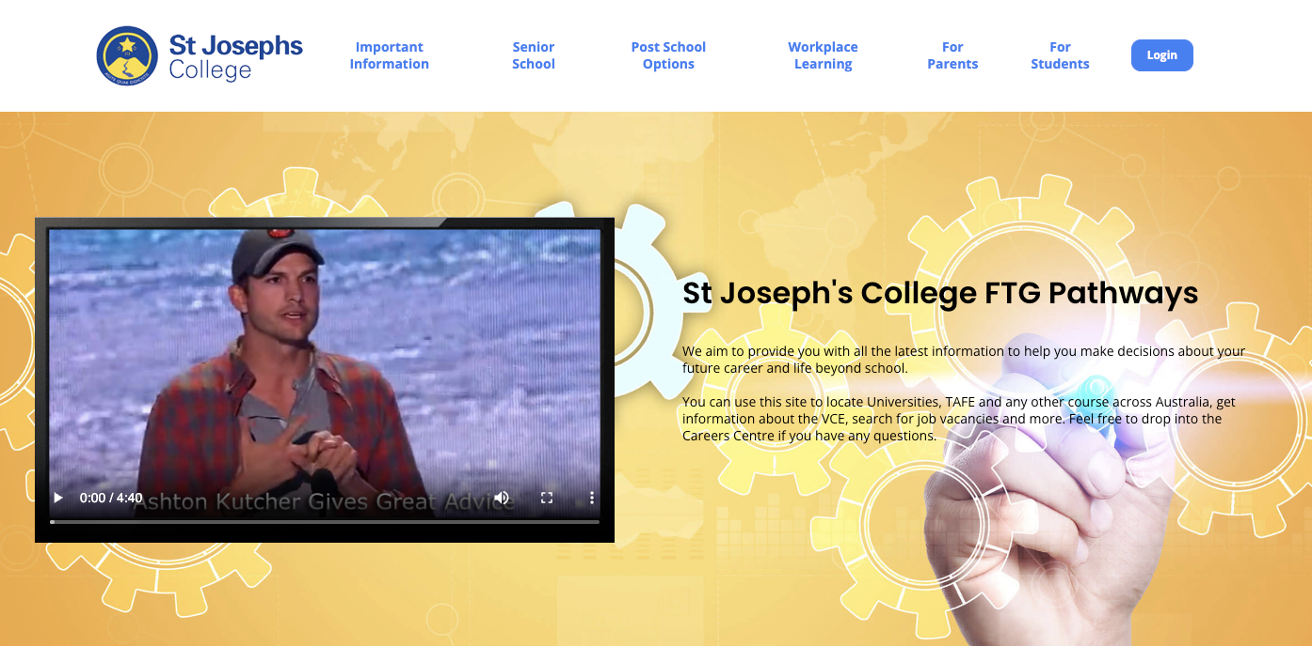
SJC
Careers Website
https://sjccareers.info/
https://sjccareers.info/
Notes:
VIV

Slide 45
SJC
College Website
https://stjosephs.com.au/
Notes:
VIV

Slide 46
VET
Vocational Education
and Training
Vivienne Egan
Director of RTO and Pathways
Notes:
VIV
VET Studies can be undertaken as part of the VCE or VCE VM Programs.
...

Slide 47

Vocational Education & Training (VET)
VET
Vocational Education
and Training
are selected studies that
MUST
be included in a
VCE Vocational Major (VCE VM) course and CAN
be included in a VCE Course
(contributing to VCE ATAR score)

Slide 48



Vocational Education & Training (VET)
VET
What is it?
May result in a nationally recognised Certificate II or III qualification
Provides credit towards the VCE to different degrees
Additional costs on top of school fees may be applicable for certain studies

Slide 49



Vocational Education & Training (VET)
VET
What is it?
Some independent travel may be involved
Most VET classes held off-campus, but some at St Joseph’s College
With a few exceptions (including: school-based VET studies) VET studies require an application form

Slide 50

Vocational Education & Training (VET)
VET
Application Online Date
Form due 9am Friday July 24

Slide 51
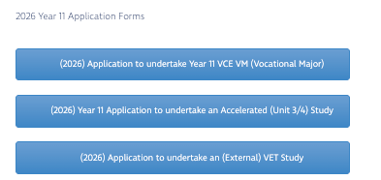

Slide 52

VCE Vocational Major
(VCE VM)
a vocational and applied learning program within the VCE
designed to be completed over a minimum of two years
prepares students to move into apprenticeships, traineeships, further education and training, university (via non-ATAR pathways) or directly into the workforce.
No exams. No ATAR score. Assessments competency based.

Slide 53


VCE VM Application
VCE VM
How do I apply?
Limited places
By application form and interview
Note: You must also pick the VCE course just in case you are unsuccessful in getting a VCE VM enrolment

Slide 54

A Balanced Program
VCE VM
How is it structured?
Four days per week of school
One day per week of (additional) VET
a week of work experience
each term

Slide 55

To be eligible to receive the VCE VM
VCE VM
How is it structured?
Complete a minimum of 16 units
(across Year 11 and 12) including a minimum of:
Literacy
3 VCE VM Literacy or VCE English units
Numeracy
2 VCE VM Numeracy or VCE Mathematics units (most students will complete 4 units)

Slide 56


Work Related Skills
2 VCE VM Work Related Skills units (most students will complete
4 units)
VCE VM
How is it structured?
Personal Development
2 VCE VM Personal Development Skills units (most students will complete four)
Religious Education
two VET credits at Certificate II level or above
Including VET Cert. II Small Business and one of student choice

Slide 57
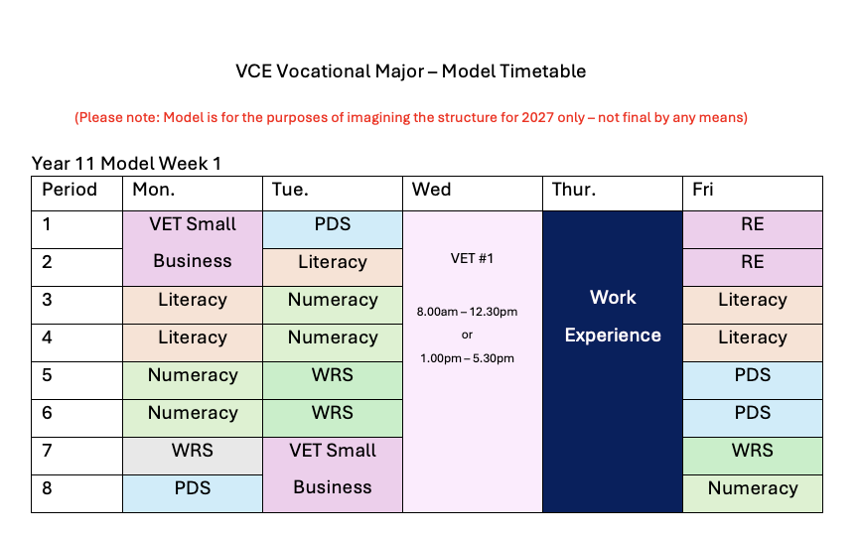

Slide 58

VET Certificate II in Small Business
(undertaken in timetable classes)
VCE VM
VET Studies
additional VET study
(undertaken either Wednesdays or Thursdays)

Slide 59
VCE VM students
will undertake
Work Placement
Approximately one week per term
VCE VM
Work Placement

Slide 60

VCE VM
Flexibility
designed to cater for students strengths and interests
VCE VM students may be able to complete VCE studies (non-scored) as part of their VCE VM Certificate
Options for students to undertake school-based apprenticeship as part of their VCE VM

Slide 61

Applying for VCE VM 2027
VCE VM
How to Apply?
Form available now
Form due 9am Friday, July 24

Slide 62
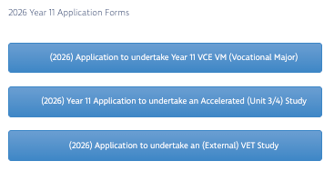

Slide 63
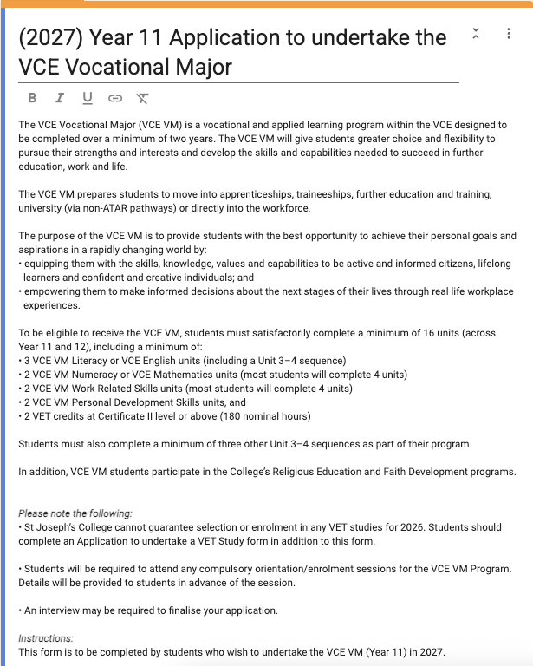
VCE VM
Google Form

Slide 64

Applying for VCE VM 2027
VCE VM
How to Apply?
Form available now
Form due 9am Friday, July 24
VCE VM Interviews from:
Monday July 20 to Friday July 24

Slide 65
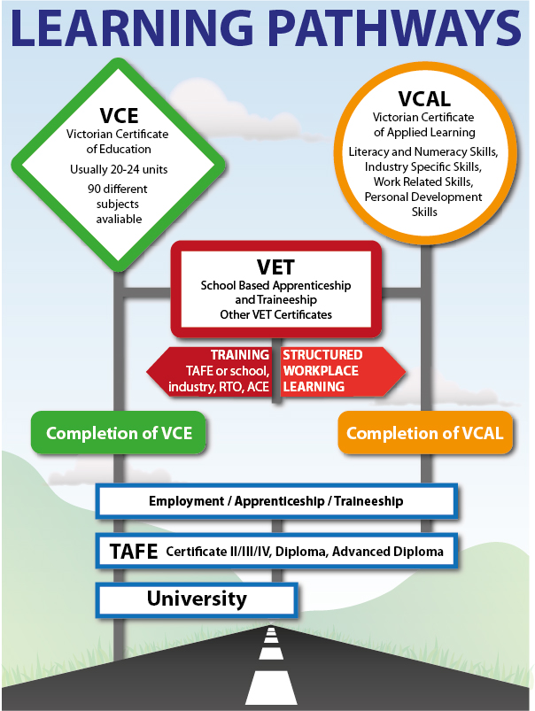
Course Selection Process
VCE, VCE VM
VCE VM
VCE VM
Notes:
Thankyou Viv
So where to from here – Course Selection

Slide 66


Talk to people
Course selection process
What do I have to do?
Think about what you want to be and find out what it takes
Read the St Joseph’s
VCE & VCE VM Course Selection Handbook 2027
Online Now!
Notes:
Students need to gather support and advice from people around them and from the resources available to them, including most importantly the VCE and VCE VM Course Selection Handbook which is now online.

Slide 67
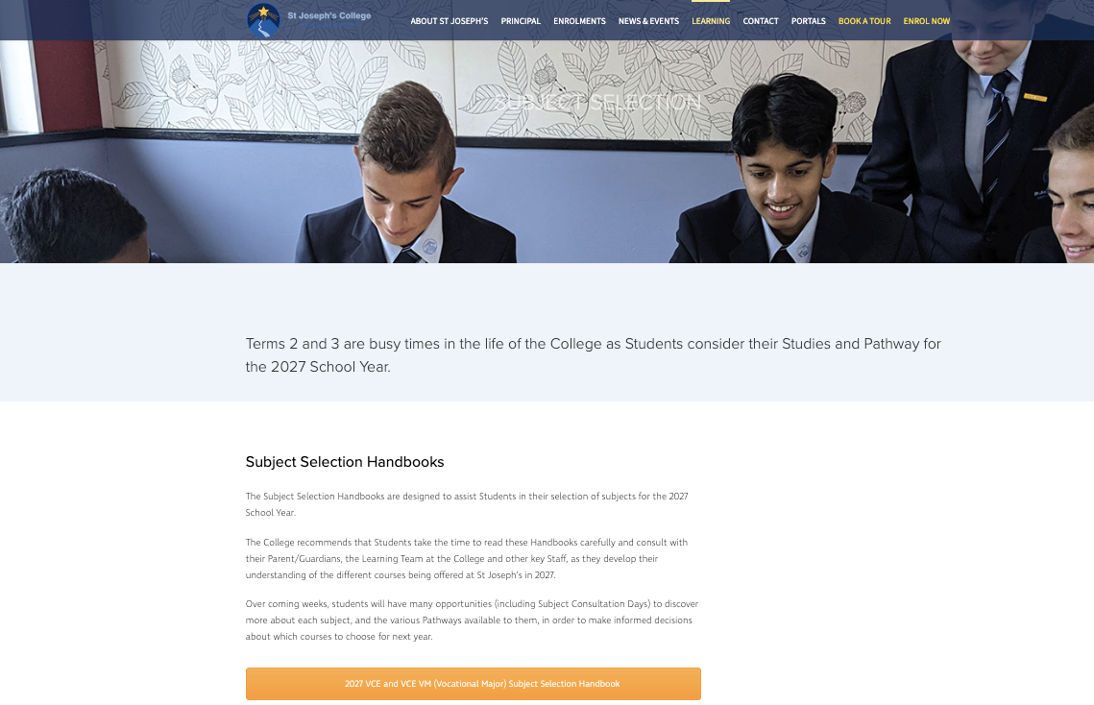

Slide 68
Talk to people
Course selection process
What do I have to do?
Think about what you want to be and find out what it takes
Read the St Joseph’s
VCE & VCE VM Course Selection Handbook 2027
Online Now!
Remember the three key questions:
Am I good at it? Do I like it?
Do I need it?
Notes:
As previously mentioned, students need to consider three questions:
. What am I good at
. What do I like
. What do I need

Slide 69


Take note of which subjects or courses require application forms
Course selection process
What do I have to do?
Keep an eye out for an email with details of the online subject selection
Attend the Course Selection Consultation appointment on Wednesday July 15
(pupil free day Year 10)
Meet all due date:
9am, Friday July 24
Notes:
If they are continuing Acceleration or applying for a VET study etc., they need to complete applicable application forms. These are available as electronic forms on the College Website.
All students and parents will have an opportunity to attend the compulsory Course Selection Consultation Meeting on Wednesday 15 July (Microsoft Teams).
With the exception of VCE VM, all applications (including Subject Selection, Applying for Accelerated Studies, VET Applications) need to be completed and submitted by Friday July 24
VCE VM Applications are due Friday July 17. Any students wishing to undertake VCE VM is still required to complete his application for VCE studies.

Slide 70
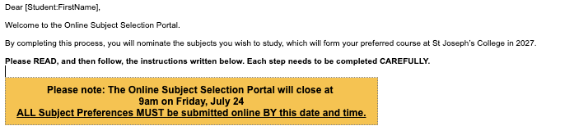
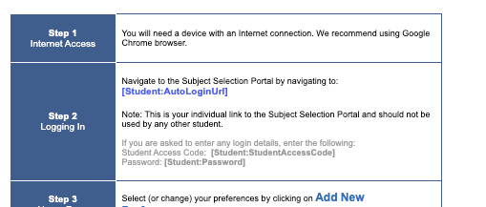
Students will receive an email containing their personalised link to the Online Subject Selection Portal.
Notes:
Students will, as of this evening or early tomorrow morning, receive an email containing their personalised link to the Online Subject Selection Portal.

Slide 71
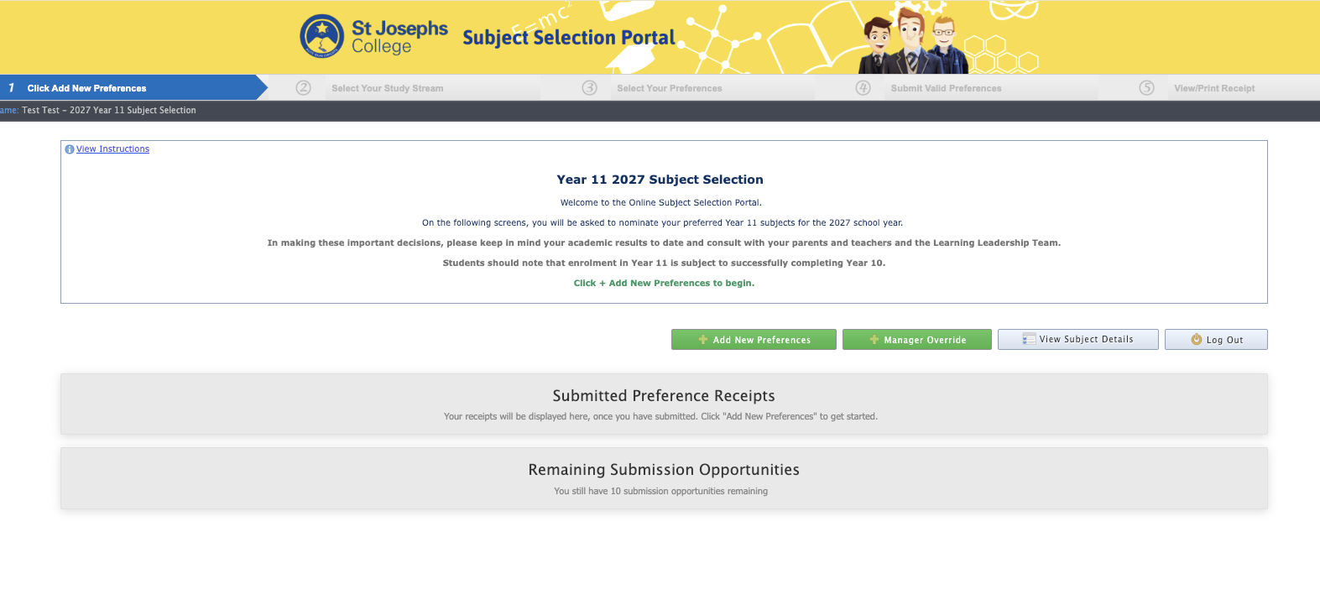
The link will take Students directly to the Subject Selection Portal Homepage.
Click + Add New Preferences to begin.
Notes:
The link will take Students directly to the Subject Selection Portal Homepage.

Slide 72
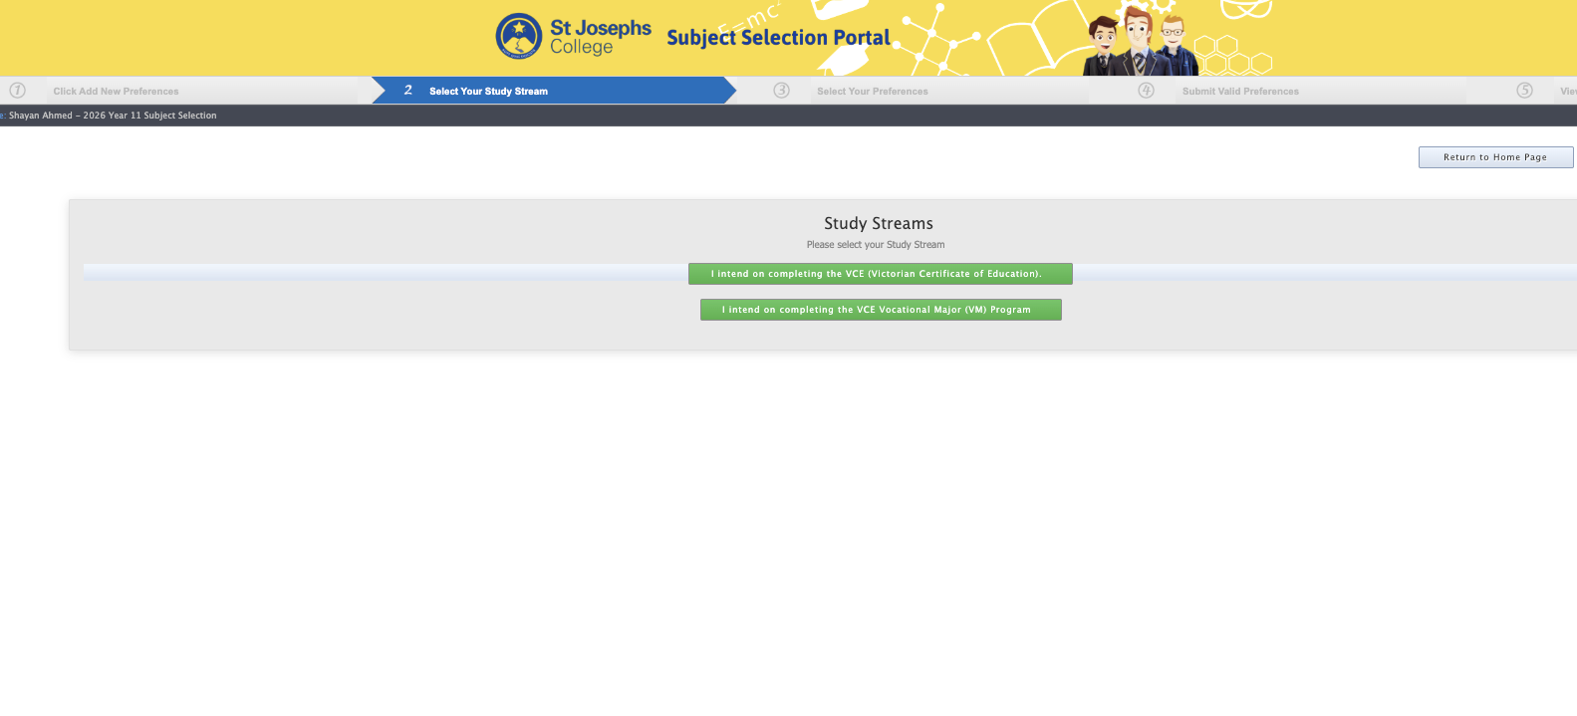
Students select their preferred program for 2027
VCE or VCE VM.
Notes:
Students select their preferred program for 2027 VCE or VCE VM.

Slide 73
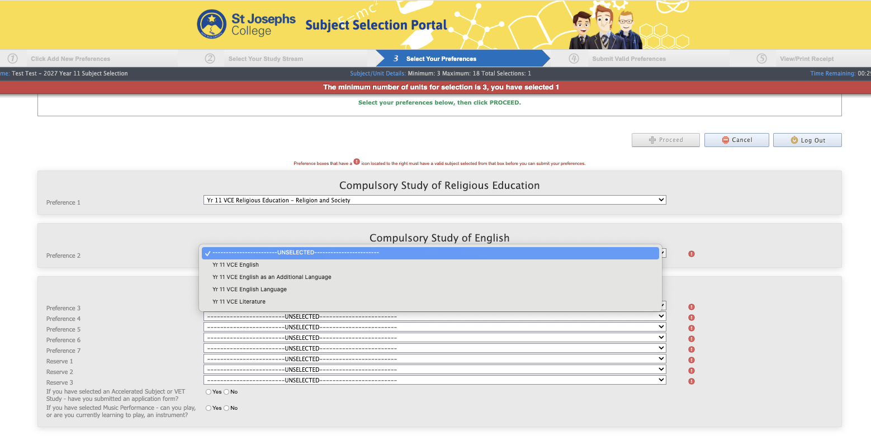
Students begin to select their preferences:
Click Proceed to continue.
Notes:
Students select their preferences starting with RE, English Block and then in order of preference (Maths is NOT automatic, it needs to be chosen!):

Slide 74
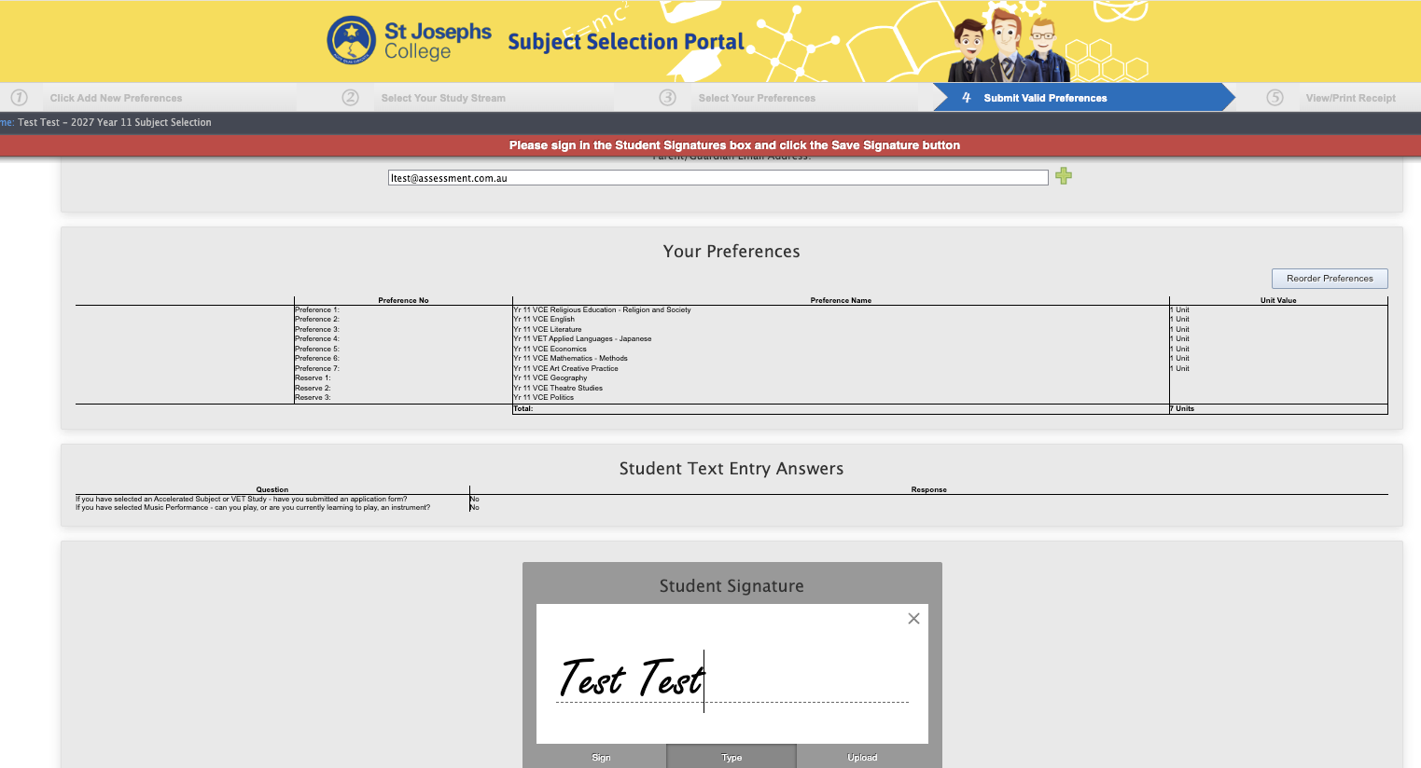

Slide 75
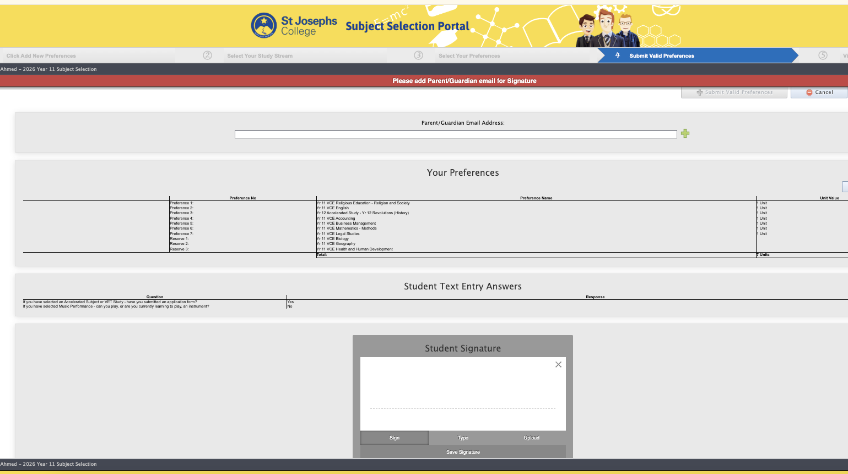
Students confirm their preferences and sign (electronically) to
acknowledge that they are correct.
Click + Submit Valid Preferences to continue.
Notes:
Students confirm their preferences and sign (electronically) to acknowledge that they are correct.

Slide 76
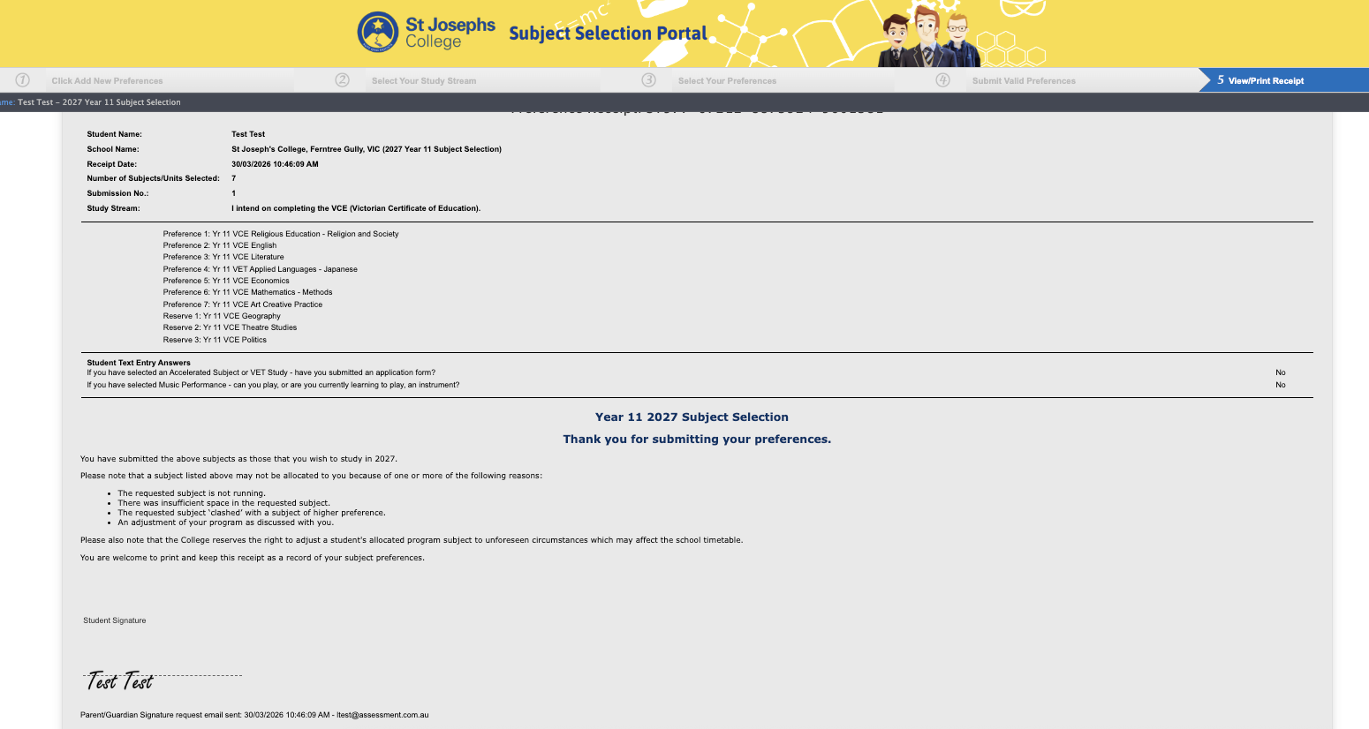
The following confirmation appears when the process is complete.
Students may repeat the entire process to change their preferences until the cut off date.
Notes:
Confirmation appears when the process is complete.
Students may repeat the entire process to change their preferences until the cut off date.

Slide 77
Year 10 pass required for any Year 11 studies
(VCE or VCE VM)
VCE directed mainly towards University, TAFE and further study
The quick version
VCE VM directed mainly towards work, apprenticeship, training
VET – certificate studies providing credit towards VCE or VCE VM
Notes:
In Summary
Pass this year!

Slide 78
VCE
Choose Your English
VCE
Decide whether continuation of Accelerated Studies is viable
The quick version
VCE
Strongly advised to continue with a Maths option
VCE
Remember the three key questions: Am I good at it? Do I like it? Do I need it?
Notes:
Choose your English
Choose your RE
Choose your 5 preference subjects and
Choose 3 Reserves – these are important
By July 24

Slide 79

VET requires an application form
continuing
Accelerated Studies
requires an application form
The quick version
Considering a VET Study?
Apply by 9am Friday July 24
Considering VCE VM?
Apply by 9am Friday July 17
Complete VCE Application also
Attend both VCE and VCE VM interviews
Notes:
Complete Google Forms for:
Continuing Acceleration, July 24
VCE VM application, July 17
VET Application July 24

Slide 80
VCE & VCE VM Course Selection Handbook 2027 now online
Course Selection Consultation,
Wednesday July 15
The quick version
Online Application Form (Acceleration) by
Friday, July 24
Online Subject Selections
(All Students, VCE and VCE VM),
Friday, July 24
Notes:
Book an interview on SIMON (like any other PTSC) for July 15 (bookings are now open I believe)

Slide 81

Thank you for your attendance
Notes:
Thank you ..
Cathy and Viv
Emily
to parents and students.
All the best ...

Slide 82

Parents and Guardians:
Please ensure you have completed registration

